Slide 1
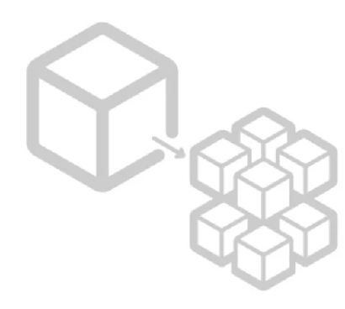
Microservices
Part 1 : Installers and first microservice

Slide 2

Discussion:
Why an architecture should use microservices ?

Slide 3
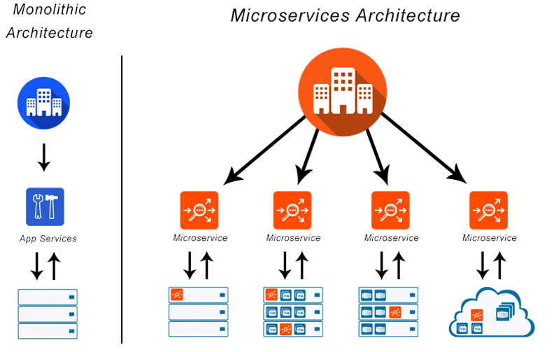
Microservices Architecture

Slide 4
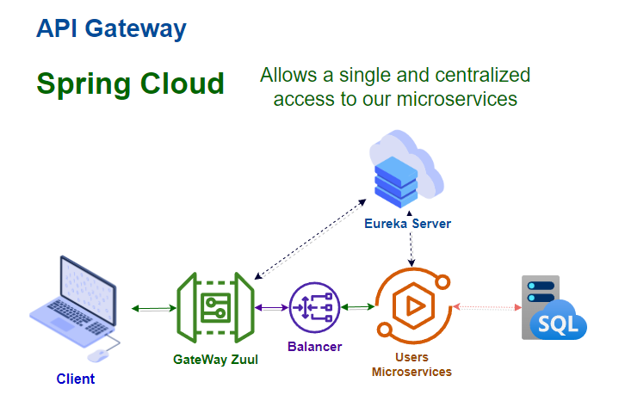
Exercise
Architecture to be replicated :

Slide 5
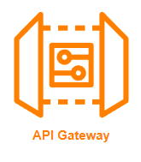
Api Gateway
An API (Application Program Interface). It is a set of instructions, protocols, and tools for building software applications. It specifies how software components should interact.
An API Gateway is a server. It is a single entry point into a system and encapsulates the internal system architecture. It provides an API that is tailored to each client. It also has other responsibilities such as authentication, monitoring, load balancing, management, and static response handling.

Slide 6
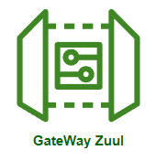
Gateway Zuul
Zuul is an API Gateway application. It handles all the requests and performs the dynamic routing of microservice applications. It works as a front door for all the requests. It is also known as Edge Server.

Slide 7
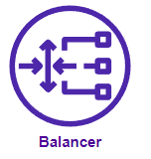
Balancer in Microservices
Load balancing is the process of sharing incoming network traffic in concurrent or discrete time between servers.
This sharing process can be evenly scale or can be performed according to certain rules.
In microservices architecture there are two type of load balancing; they are server side load balancing and client side load balancing.

Slide 8
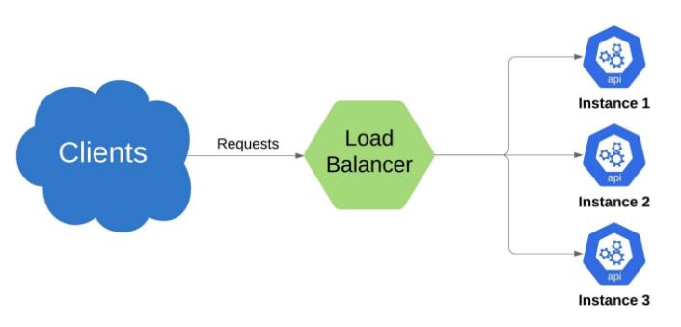
Server Side Load balancer
In this type of balancing the traffic is distributed by a load distributor that will perform the main work equally or according to certain rules.

Slide 9
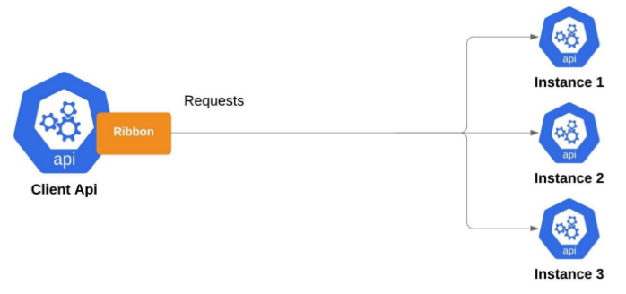
Client Side Load Balancing
In this case the client handles the load balancing and the client API should know all server instances addresses via hard coded or with a service registry.

Slide 10
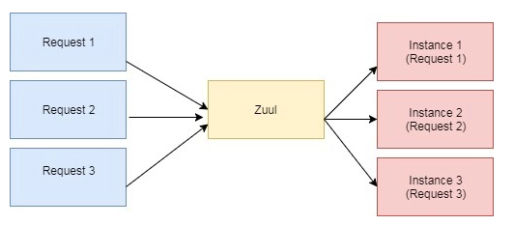
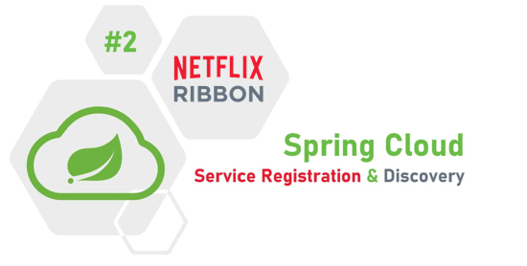
Zuul Load Balancer
When Zuul receives a request, it picks up one of the physical locations available and forwards requests to the actual service instance. The whole process is provided out of the box with no additional configurations needed.
Zuul internally uses Netflix Ribbon (Cloud Library) to look up for all instances of the service (Eureka Server) to do the server-side load balancing.

Slide 11
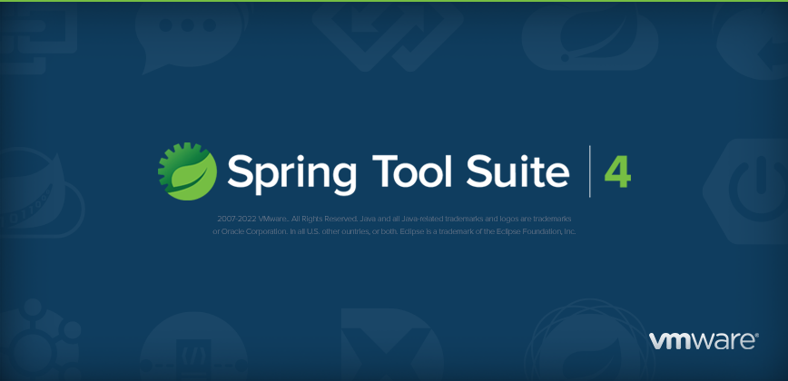
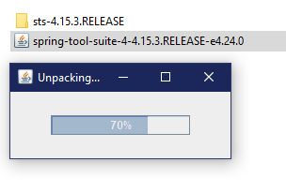
Preliminary considerations:
Download the Spring Tool Suite IDE, URL :https://spring.io/tools/
For the Spring Tool Suite version, both Git and Maven are also added in the installation.
JDK 8

Slide 12

Let’s Code

Slide 13
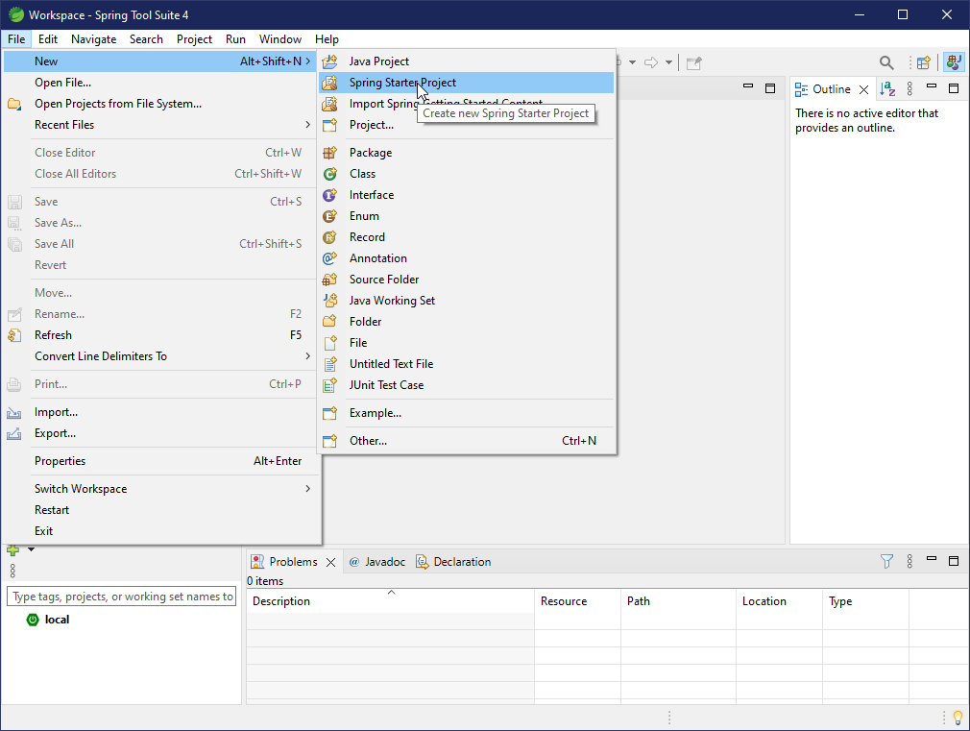
Creating the user microservice

Slide 14
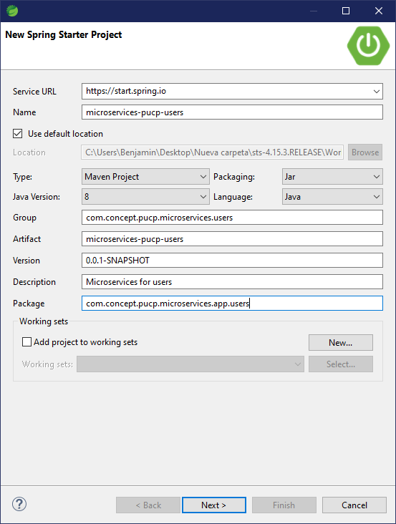
Creating the user microservice
We proceed to create a Project:

Slide 15
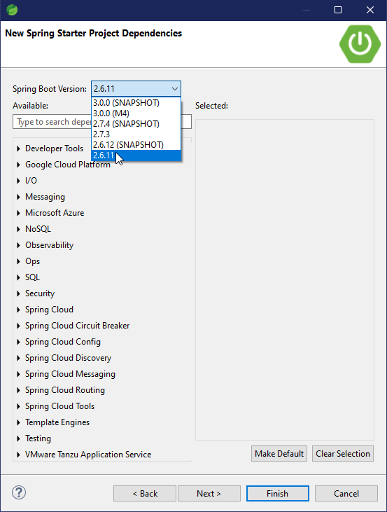
Creating the user microservice
A stable version is selected:

Slide 16
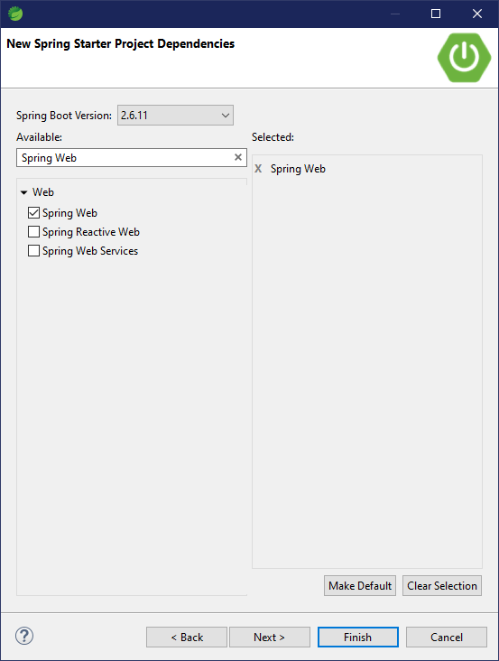
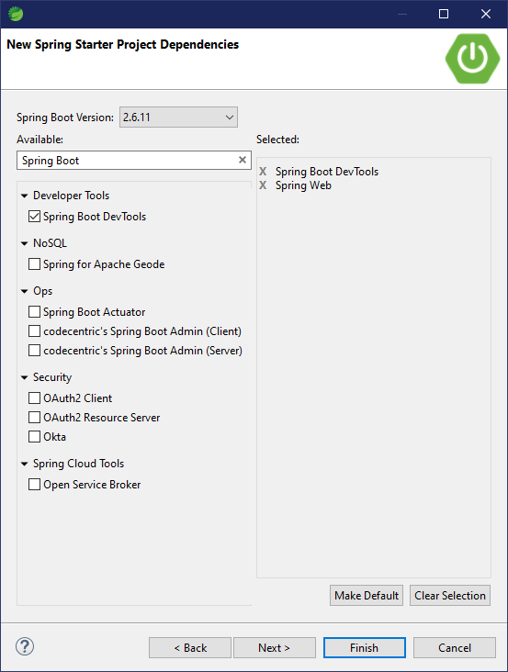
Creating the user microservice

Slide 17
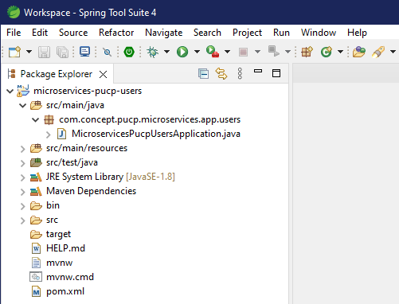
Creating the user microservice
The project is created

Slide 18
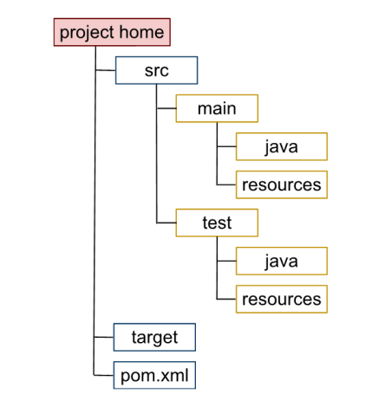
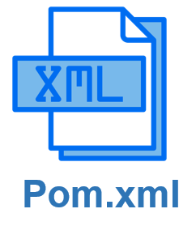
What is Pom.xml?
The basic unit of work is the Project Object Model (POM).
It is an XML file that is found by default in the root of the projects and contains all the information of the project, its configuration, its dependencies and more information.

Slide 19
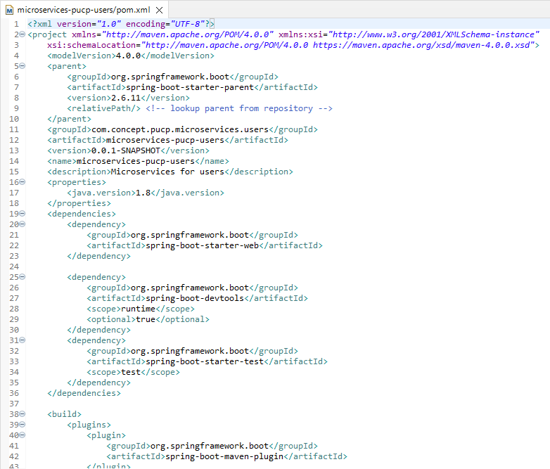
Pom.xml from our microservice
Reviewing the pom.xml file:

Slide 20
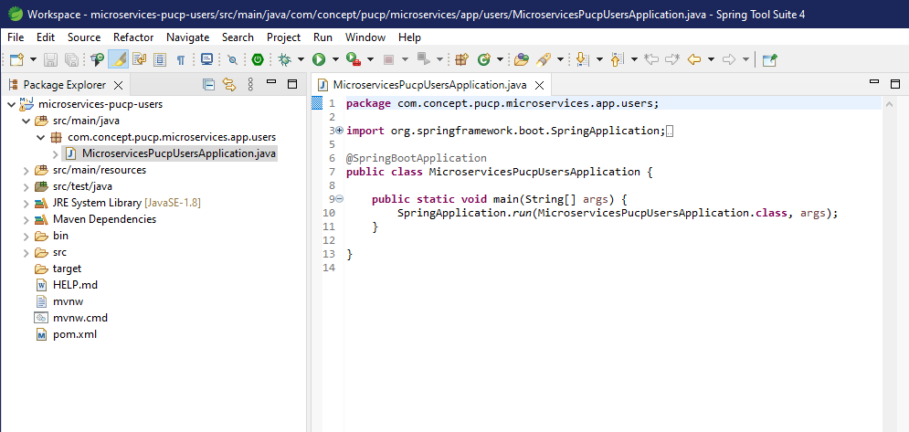
Coding the user microservice
We review the main class :

Slide 21

The Service Layer
A service layer is a layer in an application that facilitates communication between the controller and the other parts of the microservice.
Furthermore, they often serve as a transaction boundary and are in charge of authorizing transactions.

Slide 22
Implementing the Service layer

Slide 23
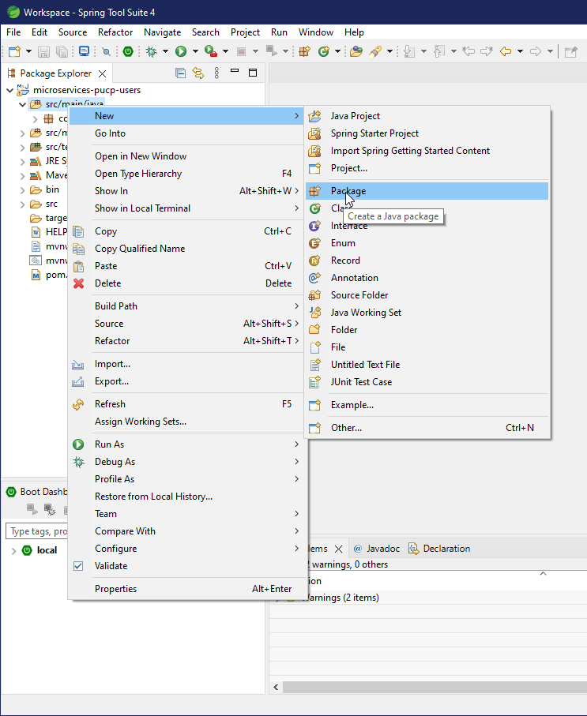
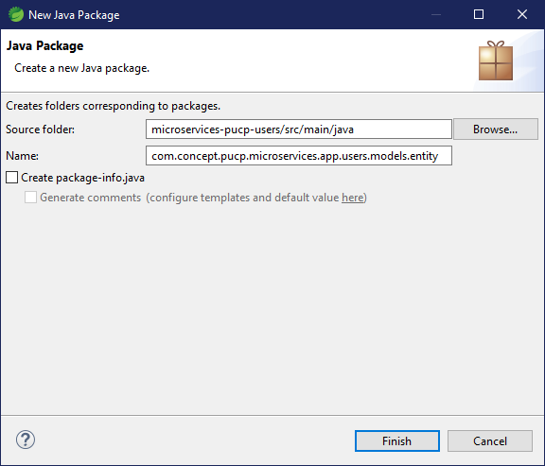
Implementing the Service layer

Slide 24
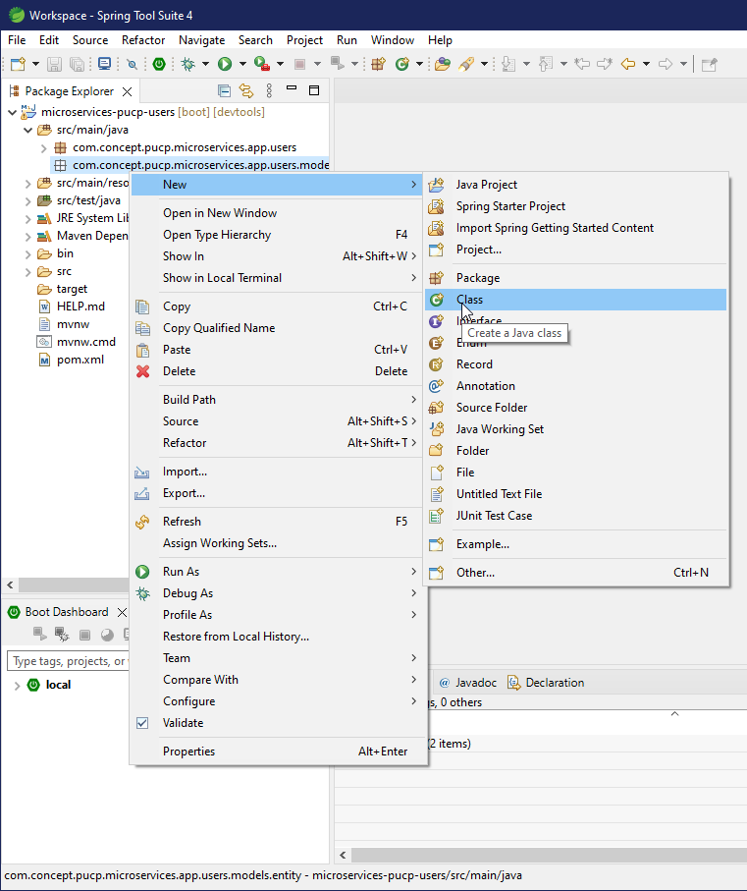
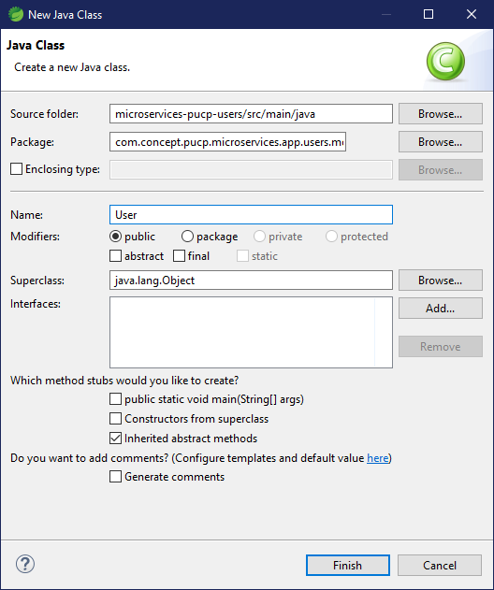
Implementing the Service layer

Slide 25
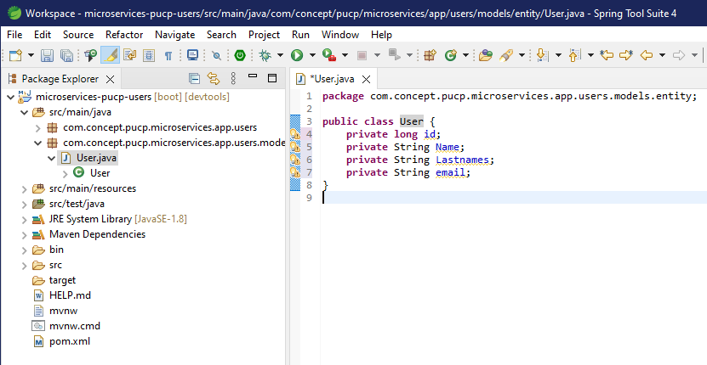
Implementing the Service layer

Slide 26
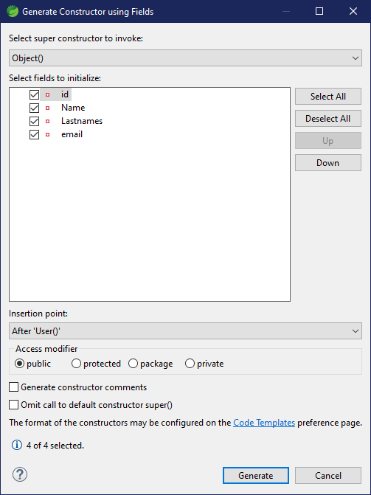
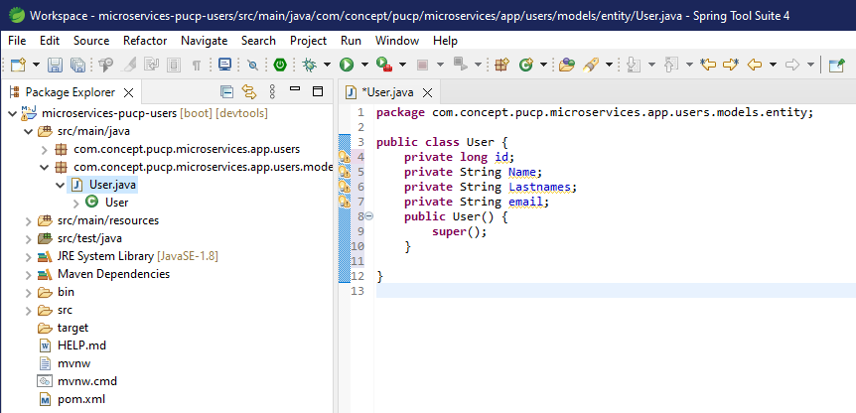
Implementing the Service layer

Slide 27
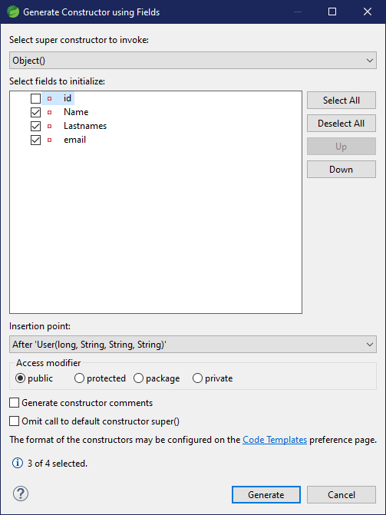
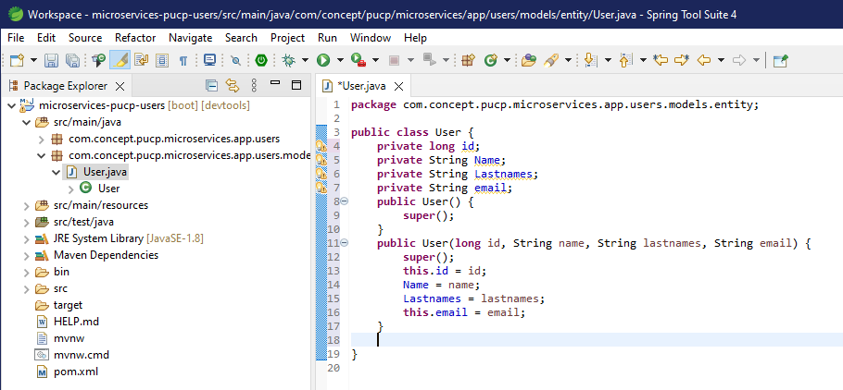
Implementing the Service layer

Slide 28
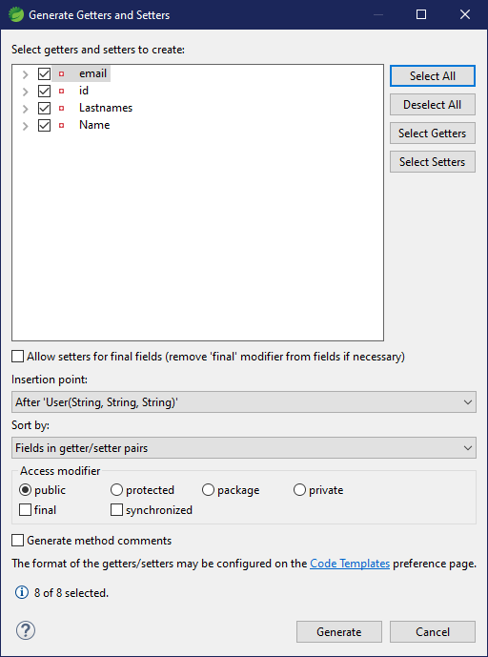
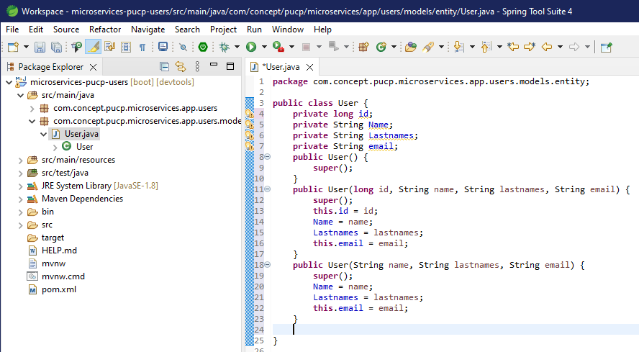
Implementing the Service layer

Slide 29
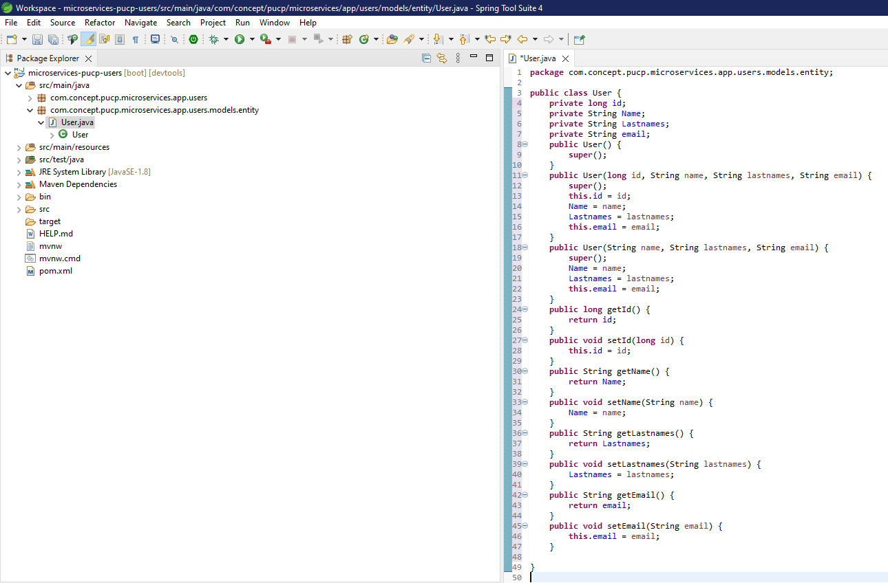
Implementing the Service layer

Slide 30
Implementing the User Service

Slide 31
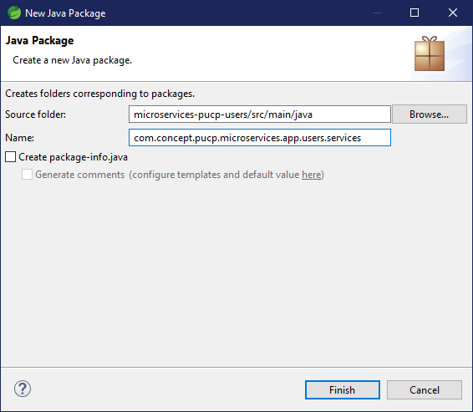
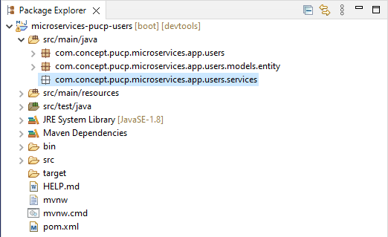
Implementing the User Service

Slide 32
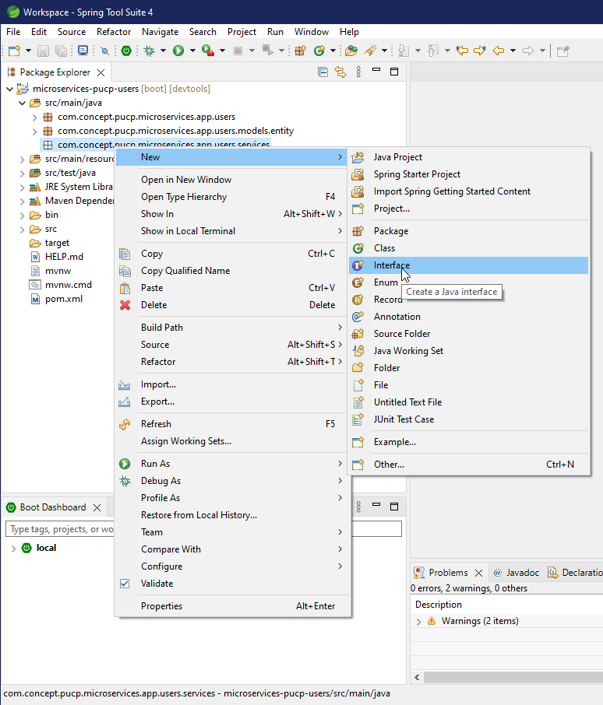
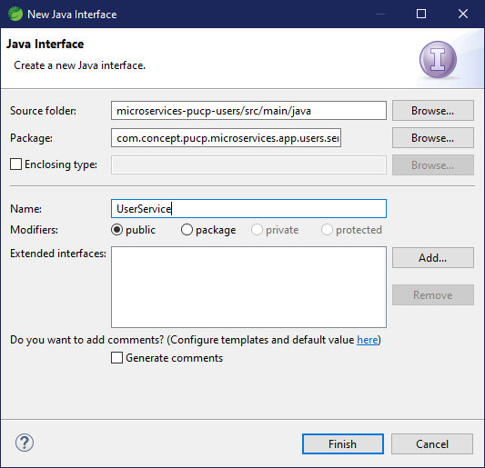
Implementing the User Service

Slide 33
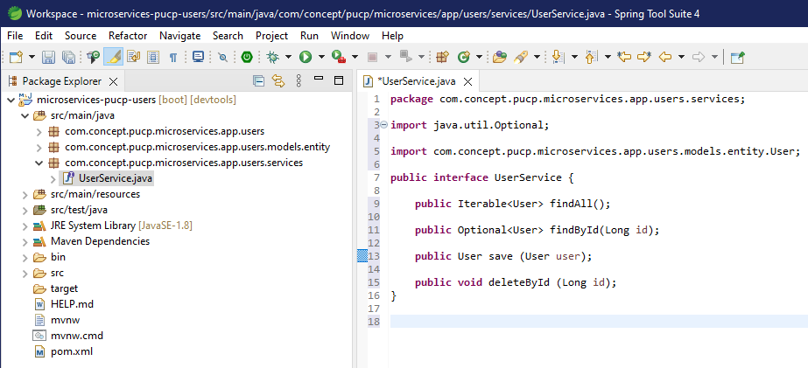
Implementing the User Service

Slide 34
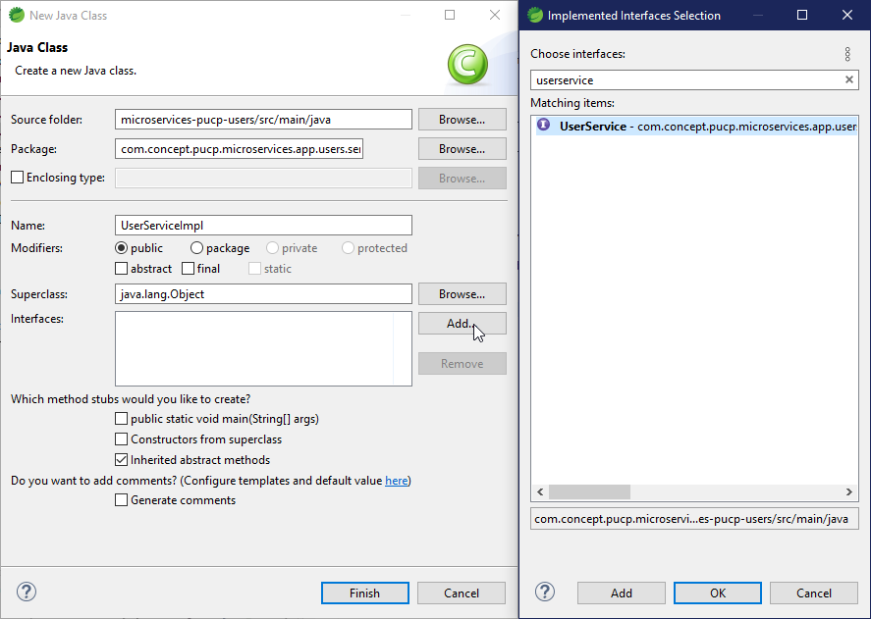
Implementing the User Service

Slide 35
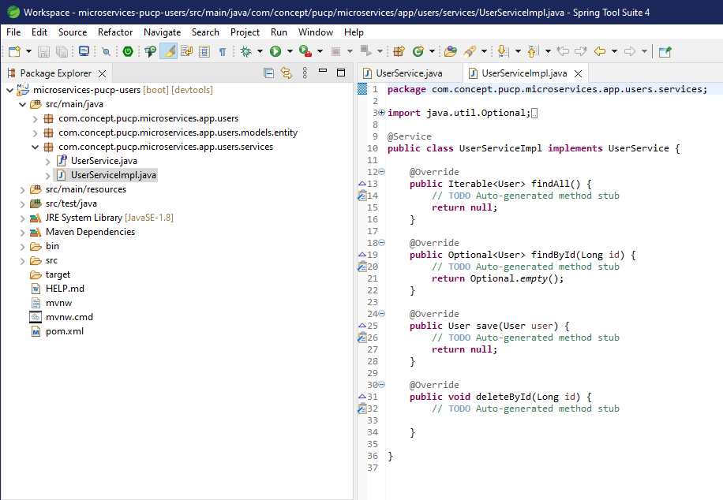
Implementing the User Service
We annotate the class UserServiceImpl with @Service

Slide 36
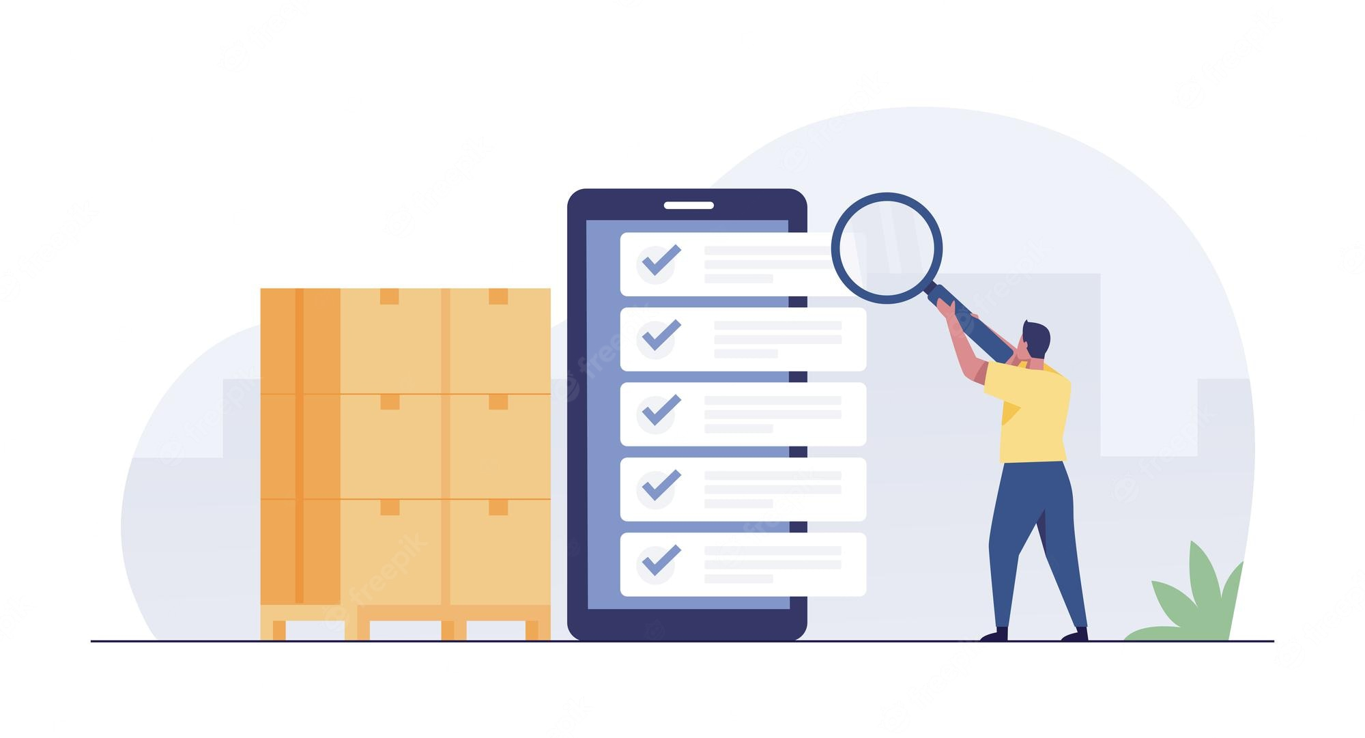
The controller
The controller maps all the request to each process & executes the requested inputs.
In a project there can be multiple controllers for different purposes but all these refers to the same server.
Also, in the controller there could be Get, Post and Delete mappings

Slide 37
Implementing the Controller

Slide 38
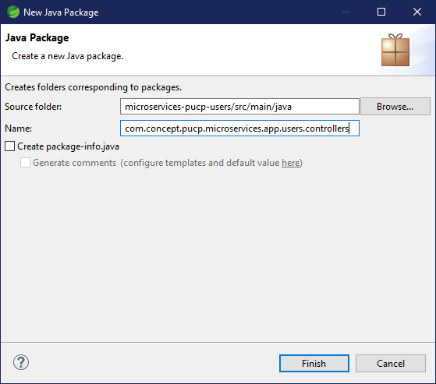
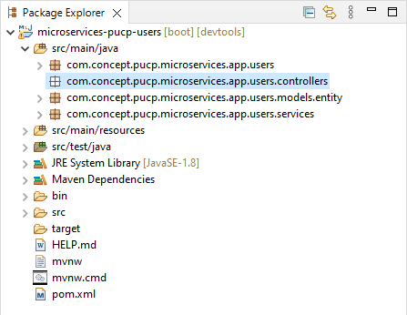
Implementing the Controller

Slide 39

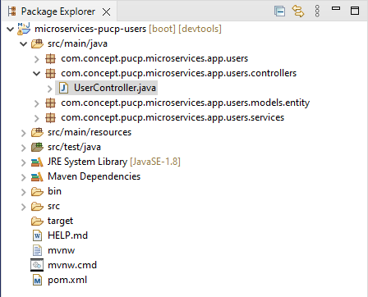
Implementing the Controller

Slide 40
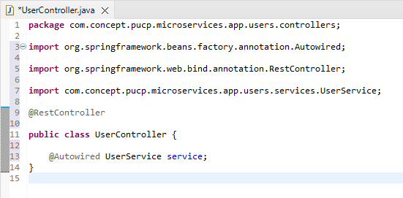
Implementing the Controller
In the UserController class:
We import @RestController for the class.
We create a variable of type UserService
The @Autowired annotation is used.

Slide 41
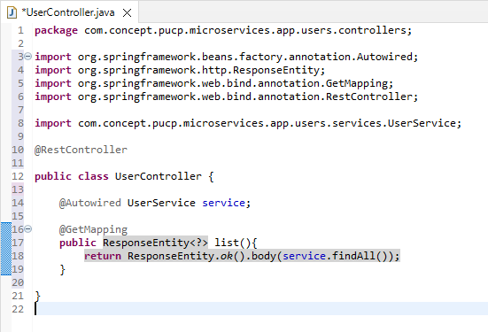
Implementing the Controller
In the UserController class:
We create a list method of type @GetMapping
The generic type ResponseEntity<?> is returned
From the response, an ok (200) is returned, and a JSON

Slide 42
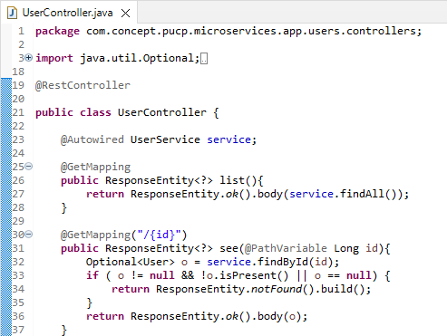
Implementing the Controller
In the UserController class:
We create a list method of type @GetMapping
The generic type ResponseEntity<?> is returned
From the response, an ok (200) is returned, and a JSON

Slide 43
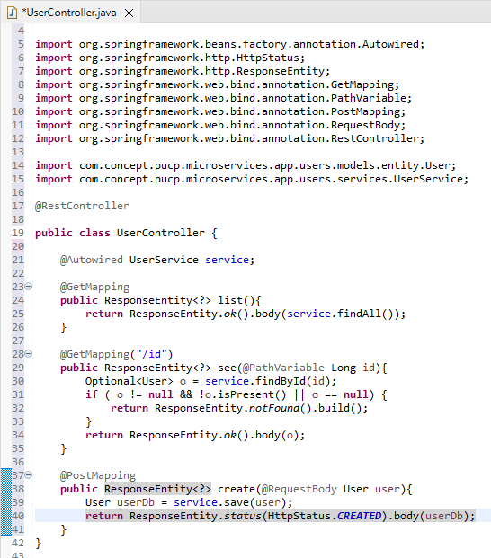
Implementing the Controller
In the UserController class:
We create a list method of type @PostMapping
The generic type ResponseEntity<?> is returned
From the response, an ok (200) is returned, and a JSON

Slide 44
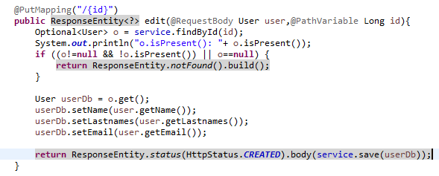
Implementing the Controller
In the UserController class:
We create a list method of type @PutMapping
The generic type ResponseEntity<?> is returned
From the response, an ok (200) is returned, and a JSON

Slide 45

Implementing the Controller
In the UserController class:
We create a list method of type @DeleteMapping
The generic type ResponseEntity<?> is returned
From the response, an ok (200) is returned, and a JSON

